Slide 1
AHRQ QI User Meeting
Validation Pilot
Lessons Learned
Laura Puzniak, PhD, MPH
Friday, September 28, 2007

Slide 2
Partner Participation
Facilitating organizations
  collaborating with one or more individual hospital
Hospital systems
  representing more than one individual hospital
Individual hospitals

Slide 3
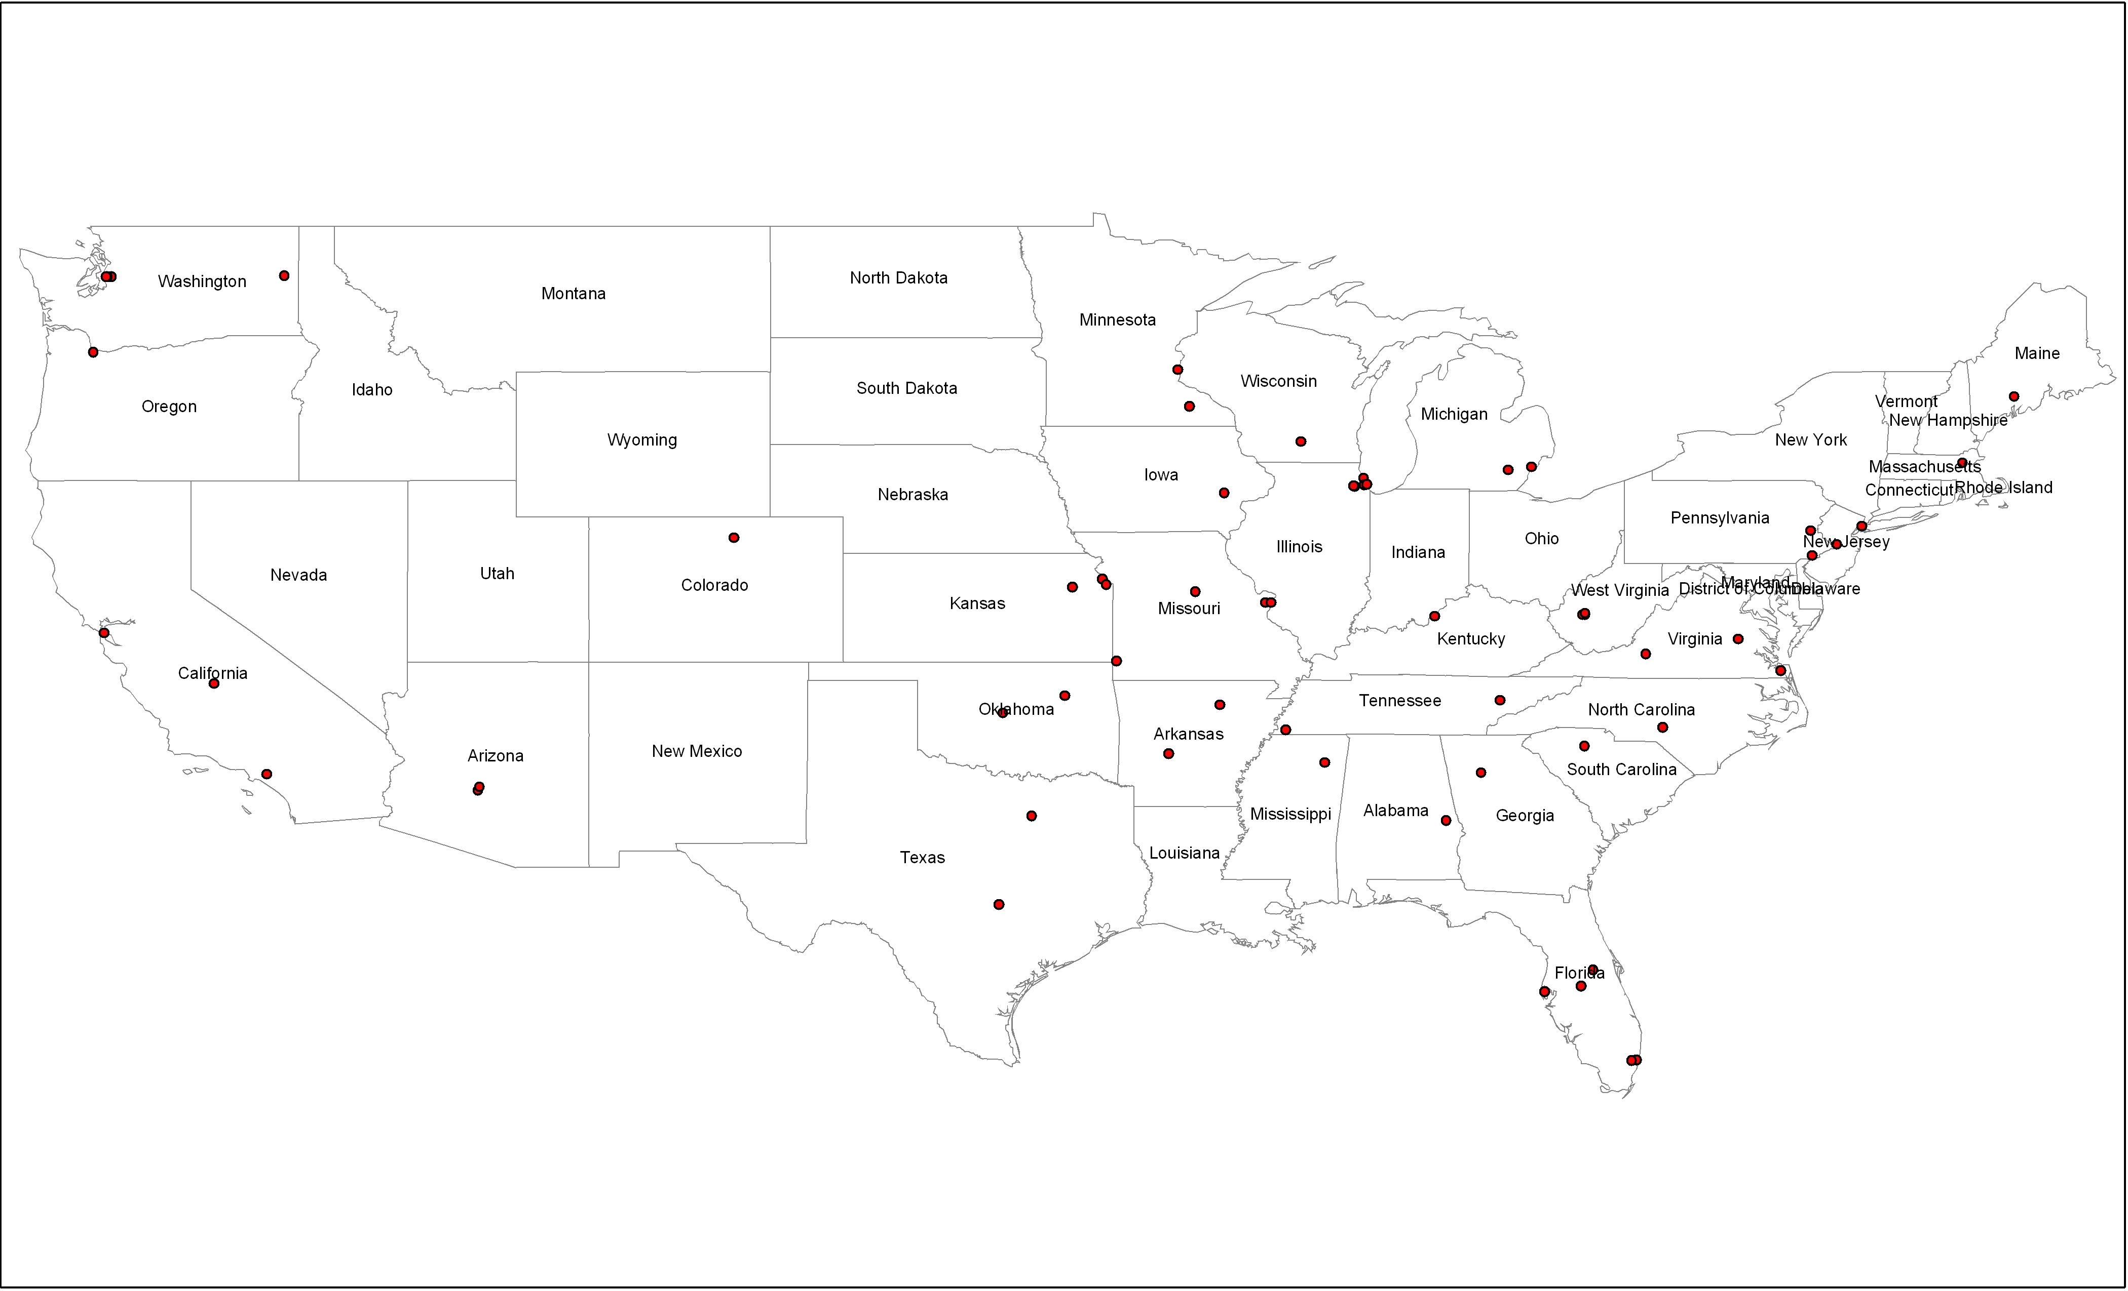
Pilot Partnerships

Slide 4
Process for Partners
Questionnaire
  Available administrative data
  Accessible medical record data
  Full or partial EMR
Attend webinars
  Project Overview
  Overview of PSIs
  Tool Abstraction
Run AHRQ QI software
  Estimates of indicator frequency
  Apply Sampling methodology
Data Abstraction

Slide 5
Outcomes for Pilot
Develop and test medical abstraction tool for validating select PSIs
Develop effective protocols to use tools
Develop and apply reliable sampling method
Develop system that is useable and applicable across healthcare settings
Obtain data to further the evidence base of the PSIs
Provide results to organizations to guide programming

Slide 6
Challenges
Correspondence
Regulatory Issues
Sampling Methodology
Data Application Development
Data Abstraction Tools/Data Entry

Slide 7
Correspondence
Magnitude of partnerships
Varying contacts per agency
Varying levels of familiarity with the indicators
Technical difficulties
Timing

Slide 8
Regulatory Issues
Varying IRB requirements per agency
HIPAA Privacy Rule
OMB Clearance

Slide 9
Sampling Methodology
Versions of application to download and run
Technical Issues

Slide 10
Data Application Development
Requirements
Timeframe
Usability

Slide 11
Data Abstraction Tools/Data Entry
Electronic Medical Records
Training
Incomplete records
Text fields

Slide 12
Phase II
Currently recruiting partners
  Contact Information
  Laura Puzniak, puzniakl@battelle.org
  Sign up for listserv, to receive notification
Training from experts on how to utilize chart abstraction for quality improvement
Additional resource to review potentially preventable complications and identify opportunities for quality improvement
Ability to play a role in the development of resources for quality improvement

